Slide 1
Programme: Nordplus Horizontal
Project title: Tell me culture
Project number: NPHZ-2024/10158
Project period: 09/2024 - 08/2026
Participants: Valodu Mape (LV), LFI (FI), Be Creative (SE), MTÜ Selts Raeküla (EE).
Tell me culture
Project number: NPHZ-2024/10158

Slide 2
Objective
To improve local language skills combining the learning process with local tourism and cultural heritage acquisition and storytelling, at the same time enhancing interest in their own region’s and countries history, thus paying more attention to less known places in regions.

Slide 3
Main activities:
Content creation: gathering local legends and stories (total: 20 different locations, 1 story per location)
* Creating storytelling cards based on the created content (total: 20 cards)
* Creating interactive game (total: 20 game-based tasks/ 1 game per location)
* Project materials will be created in all official partner languages and English as an intermediary language.
2 local tours per partner based on the content - one as a part of piloting, another-as part of dissemination. (10-15 participants per event)
Transnational meetings one in Latvia and one in Finland, (2 participants per partner) one mobility (4 participants per partner) in Sweden.
Valodu Mape will lead all activities and create the website, as well as visual identity of the project.
All partners will be involved in the above described as well as creating content for newsletters and social media posts & publication in local media.
Valodu Mape will create a dissemination plan & schedule.
Responsibilities of each partner are described in partner agreements.

Slide 4
Full Gantt chart available here.

Slide 7
Management
Partner agreements:
Bring the originals
Communication:
The official internal communication channel: email.
Monthly or bimonthly online meetings: Zoom. The meetings will be recorded (if needed) and published for internal use only.
Meeting minutes in TPMs: provided by the hosts
Storing the content: Google Drive, a folder specially designed for the project shared with partners.
Maintenance of the content: Google Drive folder and its content will be officially available the whole project length and 5 years after the project ends, the same rule applies to the project’s social media and website management.
Availability of the project results: undetermined
Evaluation:
Internal evaluation after each activity, TPM evaluation
External evaluation: both tours of which one is LTT (student mobility)

Slide 8
Management
Kick-off meeting: online, Zoom, 11/09/2024
TPM 1 in Helsinki: 7-8/10/2024
TPM 2 in Valmiera: 10-11.06.2025.
LTT in Sweden: spring 2026 - cik dienas? Vai var mainīt vietu?
Next online meeting - 13/11/2024 11:00 CET
Before TPM
The host takes care of the meeting organisation: agenda, participant list, participant survey, photos, other documentation, if needed.
After TPM
All TPM documents should be uploaded in the Google Drive Management folder. Participant list must be signed, stamped, and scanned. The host provides meeting minutes
Logos: Please upload partner logos

Slide 9
Tell me culture in numbers
Quantitative measures:
20 less known locations in partner countries (5 locations per country, 1 story per location)
20 storytelling cards (1 card per location)
20 game-based tasks (1 per location)
2 local tours (~150 participants in total)
2 TPMs (in Latvia and in Finland)
1 mobility (4 participants per partner)
300-500 people reached, including social media
3-4 newsletters (1 per partner)
At least 1 social media post every 2 weeks
1 publication in local media

Slide 10
WP2: Guide for educators
Local surveys with 7-10 students & 7-10 educators
Topics (1-2 pages):
The importance of preserving local languages: VM
Interaction between local tourism offers and the development of small languages: B-Creative
The impact of cultural heritage on learning habits - MTU Selts Raekula
Context-based learning process emphasising storytelling as part of exploration of local cultural heritage: LFI
10 questions (yes/no, scale, open answers)
Guide content will be collected in a written form, yet we will present it digitally in a form of reels/videos to make it more attractive for target audience.

Slide 11
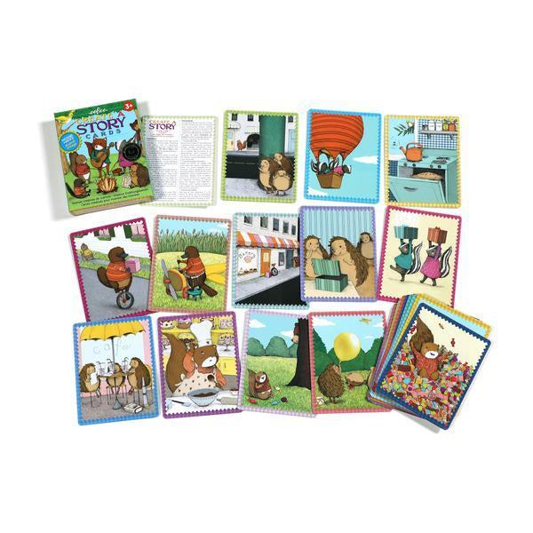
WP3: Educational resources
Purpose of the storytelling cards - imagine, analyse, understand
Ideas:
Keyword-based task;
Missing words;
Create story from pictures;
Observe the picture, describe the vibe of the story;
Use (adjectives/verbs/…) to interpret the story.
Relate yourself to the situation
Match picture with ….
Historic photos
Etc.

Slide 12
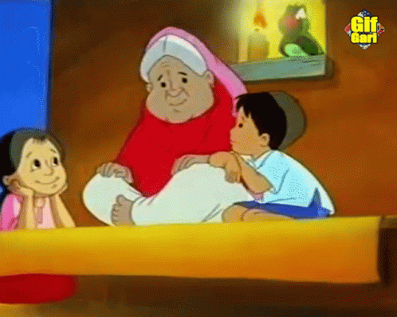
WP3: Educational resources
Interactive game to work on context-based learning:
10 questions per story
Questions that require understanding the context and content of the story
Linguistic questions:
“find a synonym/antonym for…”
“what does “...” mean?” etc.
Culture-based questions:
“Have you heard similar stories in your family/village?”
“How different does this place look now?”
“What is this person’s heritage and how it impacts your place?”
Audio-record each story.

Slide 13
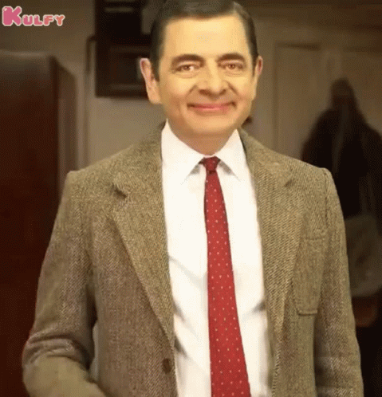
WP4: Piloting the project
Local piloting with students (5-10 students per partner)
Pilot the storytelling cards and interactive tasks
External evaluation
LTT in Sweden

Slide 14
WP5: Dissemination
2 local tours per partner based on the content - one as a part of piloting, another-as part of dissemination. (30 participants per country)
All results will be available in English, Latvian, Swedish, Estonian and Finnish languages.
Valodu Mape creates a project’s FB page.
Upload organisation logos&Add SM accounts
Dissemination log
Use hashtags #Nordplus #TellMeCultureProject

Slide 15
To-do
Ask agency about number of LTT days and change of location - VM
Create survey by 18/10- VM
Check the survey by 23/10 - all
Translate and share surveys locally - all by 30/10
1st newsletter and template by 15/11- LFI
Social media account by 23/10- VM
Google website - end of year - BCreative
Next online meeting 13/11 11:00 CET

